Slide 1

Elastic Container Service
Tutorial
May 28, 2020

Slide 2
Objective
Start up a container-based, 2-tier microservice app on ECS
Provisioning a VPC using Cloud Formation
Set up Tasks, Services, and Clusters in ECS
Trigger failures in the app and observe ECS’s response
Tear down the environment

Slide 3
What is ECS?
Key Concepts
Tutorial
Environment Setup
VPC and Startup
Create Tasks
Create Clusters
Create Services
Observations
Replace Failed Service
Auto-scale for CPU Usage
Conclusions
Table of Contents

Slide 4
Elastic Container Service
“Amazon Elastic Container Service (Amazon ECS) is a highly scalable, fast, container management service that makes it easy to run, stop, and manage Docker containers on a cluster.” ¹
Works natively with other AWS products including Route 53, IAM, CloudWatch, ECR
CI/CD Integration
Service Discovery
Support for Serverless (FARGATE)
1. AWS ECS Developers Guide

Slide 5
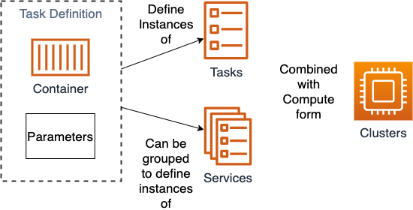
Key Concepts
Task Definition
The combination of a container image and run-time parameters
Task
A running instance of a task definition
Service
Runs and maintains a specified number of tasks
Cluster
A logical grouping of tasks or services
EC2 Container Instances (When Used)
Service Prov

Slide 6
Experimental Setup

Slide 7
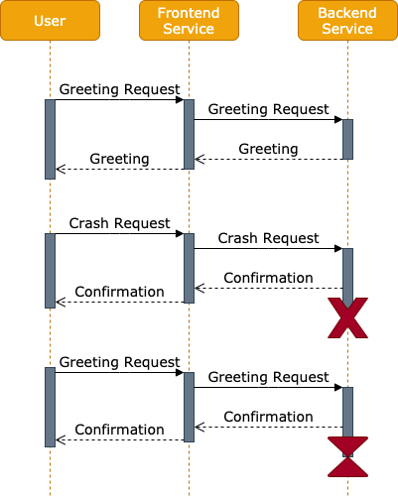
The Application
2 REST Microservices, Public and Private
Both services have the same API
/greeting
/crash
/infinite
Public forwards requests to Private
Private performs actions
/greeting – return “Hello World” and invocation counter
/crash – start a new thread. Wait 5 seconds and then exit the program.
/infinite – start a new thread in an infinite loop.
Notes:
The code for the services is provided in the attached repos.

Slide 8
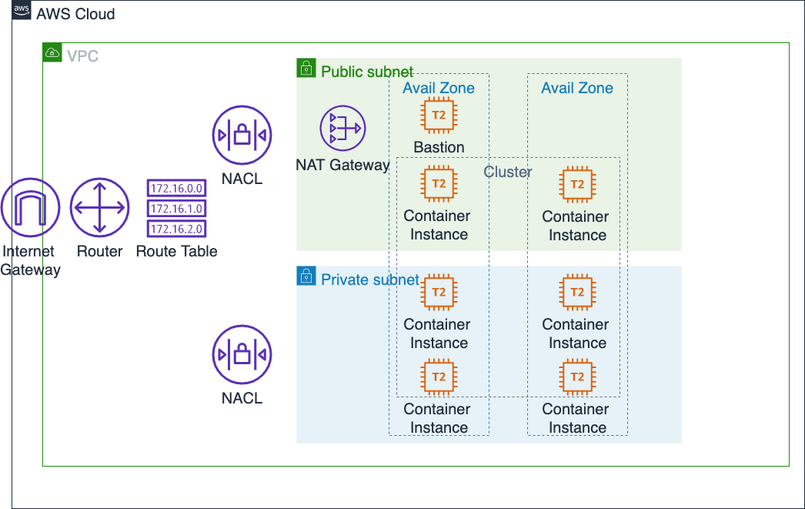
Cloud Configuration
Notes:
The services must be deployed into a Virtual Private Cloud. For this lab we’ve provided a cloud formation script

Slide 9
Environment Setup and Teardown
AWS Credentials
Have an AWS IAM Login with permissions to create ECR Repos
Install the AWS CLI
Sign into CLI – Set region to us-east-2
Create an SSH Keypair in AWS KMS
Clone the repository
Execute script setup_environment.sh
Builds docker containers for public-service and private-service
Creates a repositories in AWS Elastic Container Registry
Pushes containers to repos
Runs cloud formation script to set up VPC
Execute script teardown_environment.sh
Deletes container repositories
Deletes cloud formation stack

Slide 10
Demonstration

Slide 11
Create Task Definition
Navigate to AWS ECR Console
Click on ”Task Definitions” in the Left Navigation panel
Click Create new Task Definition
Select EC2
Name your task for the private or public service
Select Network Mode awsvpc to allow for top level service discovery
Enter 256 for Task Memory and Task CPU
Click Add Container
Add the URI for the appropriate container repo
Confirm the hard memory limit of 128
nvisia-confidential | 11

Slide 12
Create Cluster
Navigate to AWS ECR Console
Click on ”Cluster” in the Left Navigation panel
Click Create Cluster
Select EC2 + Networking (This will cost $)
Name your cluster for the private or public service
Select T2 Micro EC2 Instance Type
For the public service 1 instance will do. For the private instance create 4.
Select your SSH key pair
Deploy into the VPC we created with the cloud formation script 10.0.0.0/16
Private cluster
nvisia-confidential | 12

Slide 13
Create Service
Navigate to Cluster -> Services
Click Create
Select EC2
Select a Task Definition
Name the service (backend for the private-service)
Select a number of tasks > 1 and <= the number of machines in the cluster
Next
Select the VPC and appropriate subnet
Under service discovery choose a service discovery name (private-service must be named backend)
Next
Skip Load Balancing
Launch Service
nvisia-confidential | 13

Slide 14
Service Discovery
Navigate to AWS Route 53
Select Hosted Zones
A Hosted zone will include your domain names from the service creation
Make sure this hosted zone is associated with your vpc
nvisia-confidential | 14

Slide 15
Need to know before you get started
Our font…
This template is set for use of Verdana font only. Verdana is the nvisia standard for all powerpoint formats.
To optimize on-screen viewing and printing when using a dark backdrop, white font is preferred.
The nvisia color palette is preloaded and available under “font color”. Use primary colors listed in the “theme” section.
nvisia-confidential | 15

Slide 16
Login
Navigate to AWS Route 53
Select Hosted Zones
A Hosted zone will include your domain names from the service creation
Make sure this hosted zone is associated with your vpc
nvisia-confidential | 16

Slide 17
Experiment!
VPN Into one of the public instances
Call frontend.local/health, frontend.local/greeting
Notice the iterator on the greeting responses
Call frontend.local/crash. Check out the backend service tasks. What’s happening?
Call frontend.local/infinite. Check out the EC2 instances. Which ones are using more compute?
nvisia-confidential | 17

